Slide 1

Fraud Transaction
By: Bansari Desai and Aniketh Suresh

Slide 2
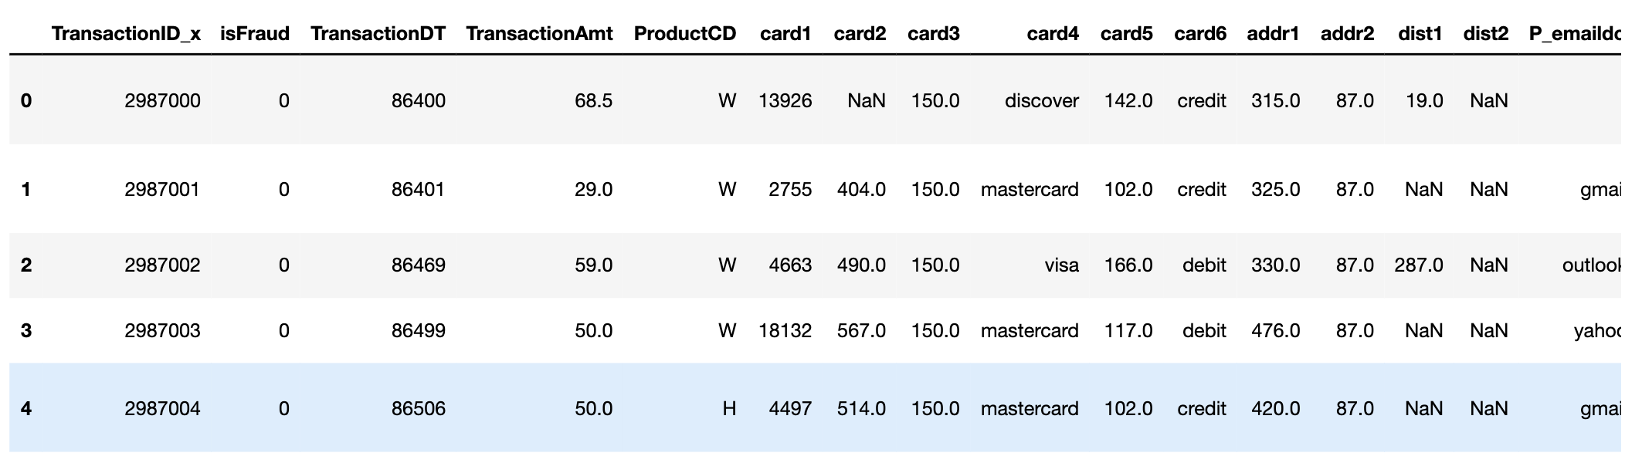
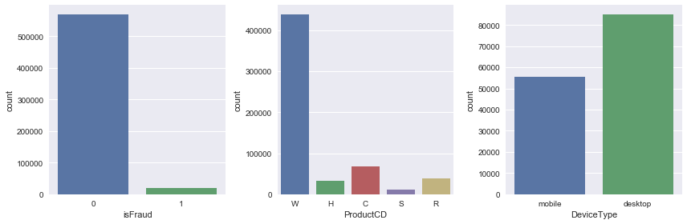
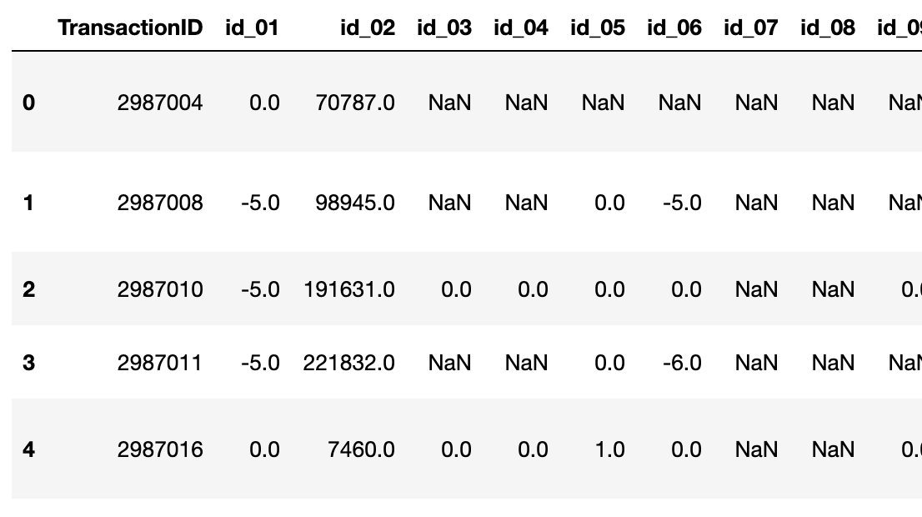
Dataset
IEEE-CIS Fraduent Transactions(KAGGLE)
GOAL – Predict if a transaction is fraudulent?
Two Datasets – Transaction and Identity
The identity section contains total of 41 features, like device type, device info, besides others.
The transaction section contains 394 features, like isFraud(yes or no), transaction amt, payment card info like card type(Visa, Mastercard), issue bank, purchaser information.
The training dataset comprises of 569,877 fraud and 20,663 legitimate samples.
Use MacOS and Google Colab TPU to execute our code.

Slide 3
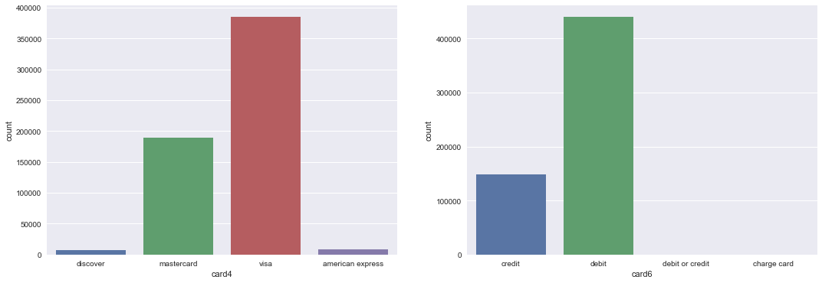
Exploratory Data Analysis
Most of the transactions are made on DeviceType as desktop, with mastercard and visa as issuer bank, and cardtype as Debit.
Most of the transactions are done on card1 with values ranging from 1k -18k and card2 with values ranging from 100-600

Slide 4
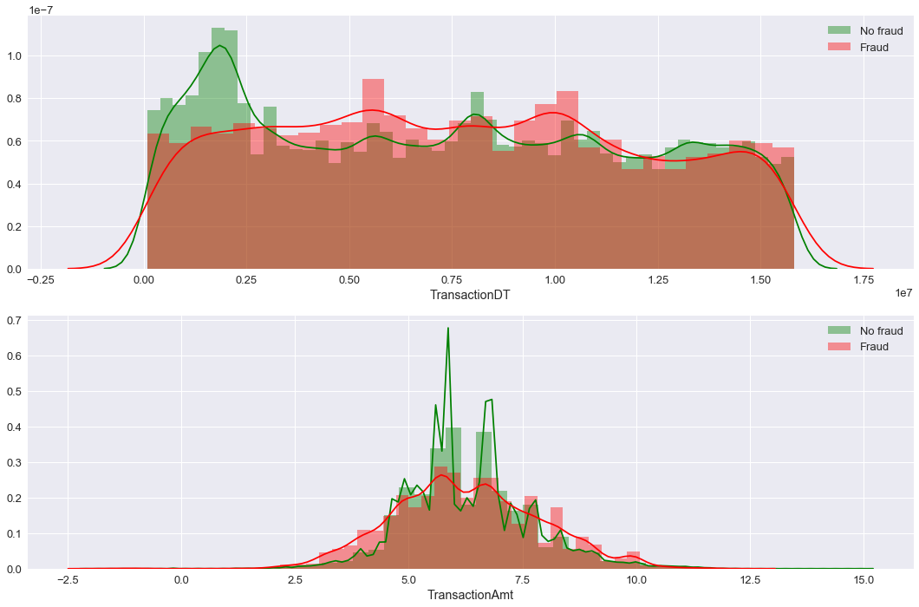
Exploratory Data Analysis
TransactionDT (time delta from some reference time): Not-Fraud transactions tend to be near to the 'Time zero reference' for the transactions; Fraud transactions tend to be a bit more evenly distributed. There is a peak around 0.55
TransanctionAmt (on dollars): Not-Fraud transactions are concentrated on the middle of the distribution, while Fraud transactions are a bit more concentrated on the tails (really small or really bit). This makes a lot of intuitive sense: micro-frauds and large-amounts-frauds are more likely.

Slide 5
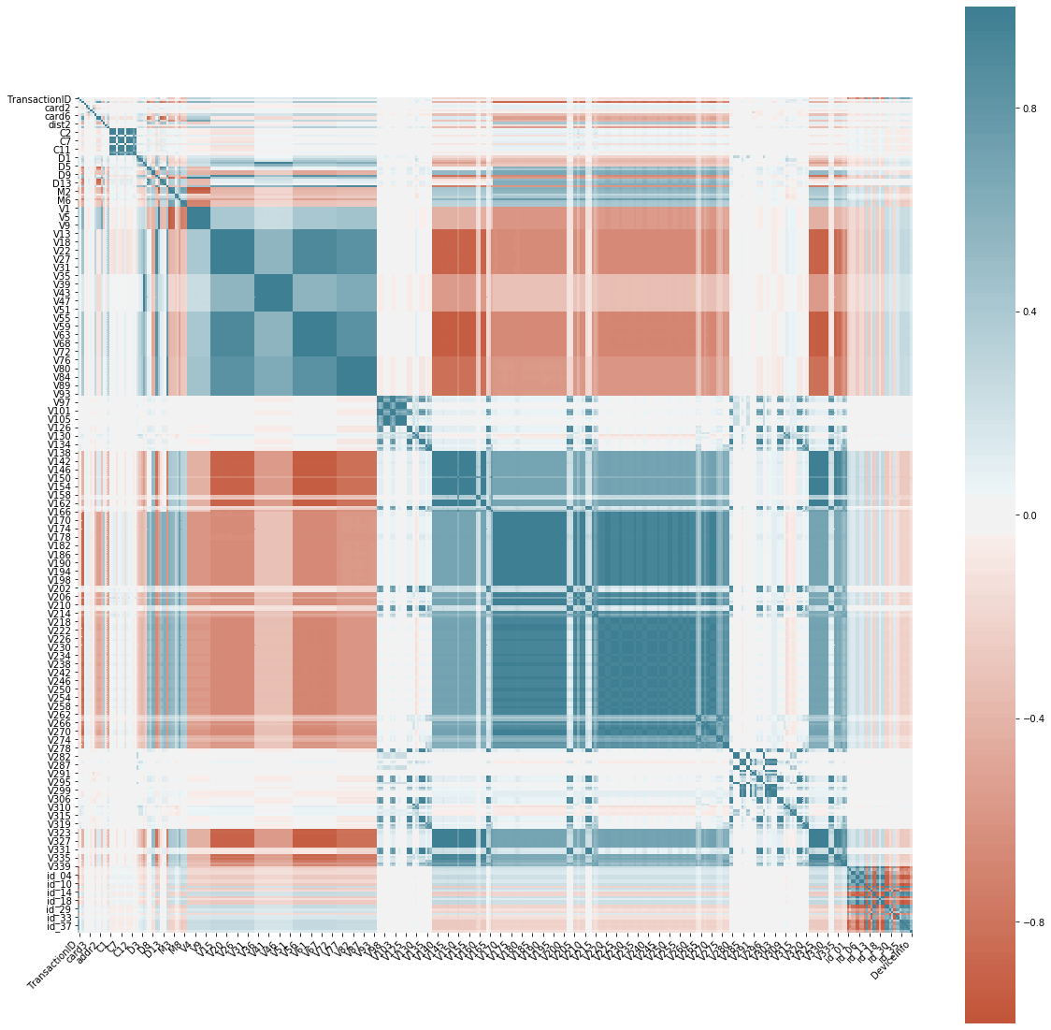
Feature Engineering
Transaction - About 196 attributes were rejected on account of correlation with other attributes, and 20% of data was missing. Most of v_’s attributes seems to have correlation with each other.
Identity – Since there was no correlation among attributes, they were not discarded

Slide 6
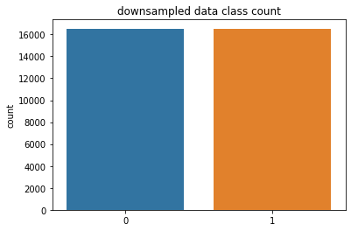
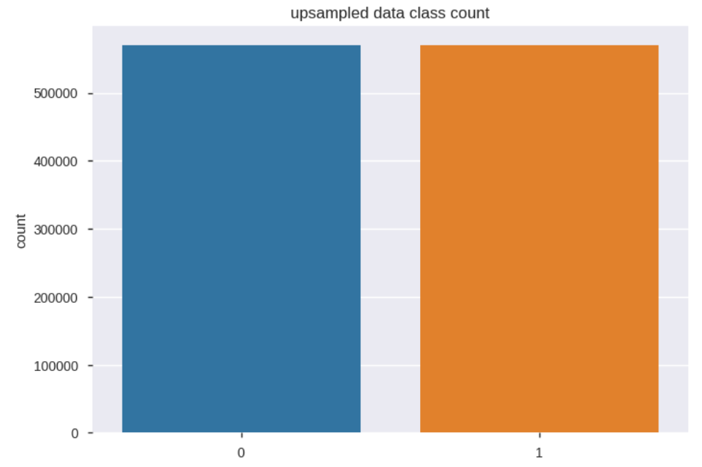
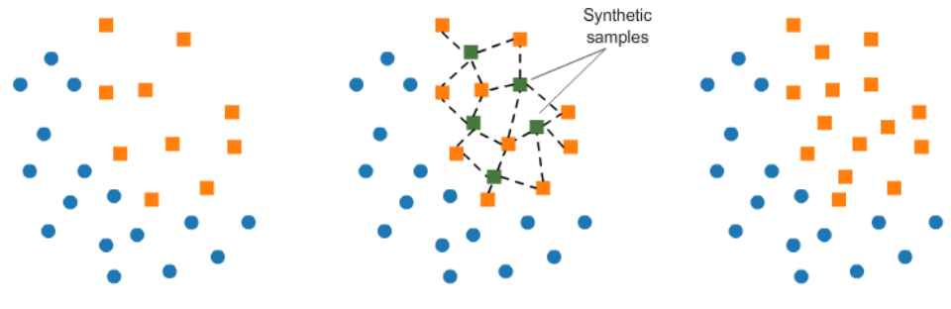
Feature Engineering
16K
16K
500K
500K
The dataset consisted over 500K non-fraudulent data and only 20K fraudulent data
Class Imbalance – We used Down-sample the majority class, Up-sample the minority class, SMOTE technique.
Using last two techniques would only increase the data set over 1M, we choose Down-sample majority class to study our model.

Slide 7
Model
Support Vector Machines | Random Forest | AdaBoost | XGBoost | DNN
Kernel: Sigmoid, Polynomial, RBF Gamma:1e-2, 1e-3, 1e-4, 1e-5 C:1,10,1e2,1e3,1e4 | No. of estimators: 100,300, 500, 800, 1000 Criterion: gini, entropy Bootstrap : True, False | No. of estimators: 10, 50, 100, 150, 200 Learning rate: 0.01, 0.05, 0.1, 0.5, 1 | Gamma: 0.5, 1, 1.5, 2, 2.5 Subsample: 0.6, 0.8, 1 Min Child Weight: 1, 5, 10 ColSample ByTree: 0.6, 0.7, 1 Max Depth: 3,4,5 | 5 layers Layer 1: 200 * Layer 2: 100 * Layer 3: 50 * Layer 4: 10 * Layer 5: 1^ Optimizer: Adam Loss: Binary Crossentropy * activation function: ReLU ^ activation function: sigmoid
The models we propose are:
1) Support Vector Machine
2) Random Forest Classifier
3) AdaBoost Classifier
4) XGBoost
5) Deep Neural Network (DNN)

Slide 8
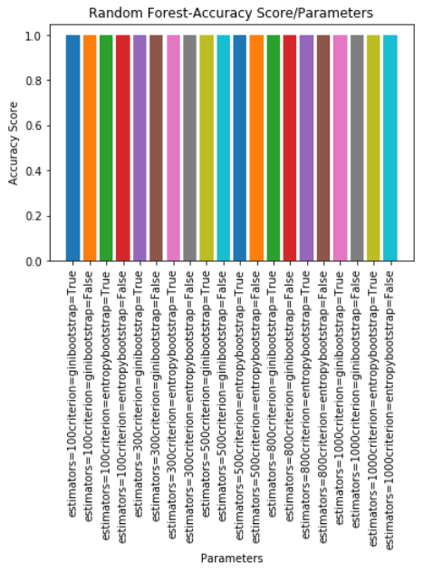
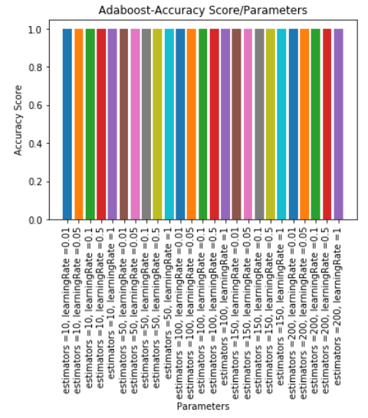
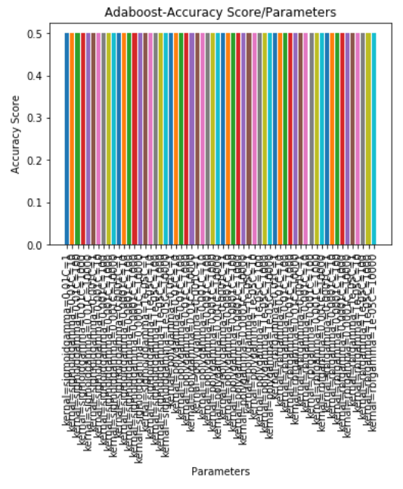
Model Comparison
SVM ~ 50% accuracy
99.9%
99.9%

Slide 9
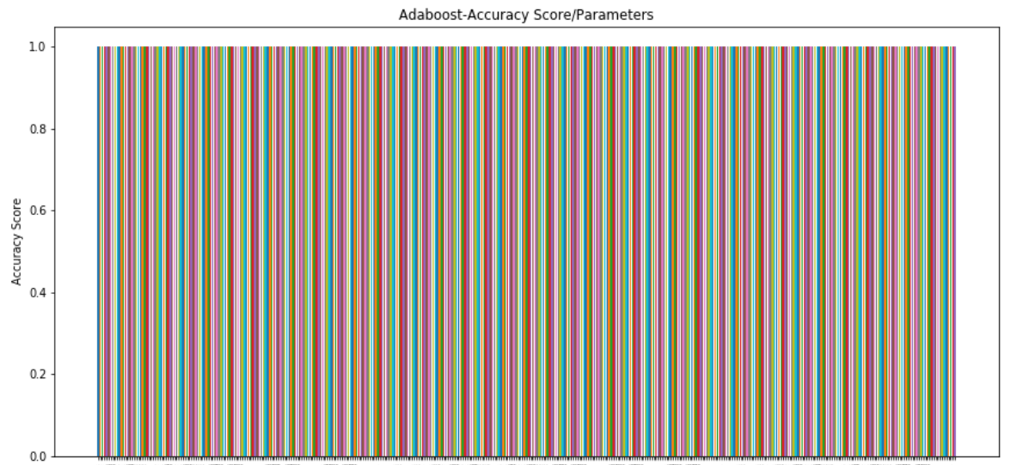



Model Comparison
XGBoost ~ 100% accuracy
Using Logistic Optimizer + Adam Optimizer:
Using RELU Optimizer + Adam Optimizer:
Using SCG + Logistic Optimizer:

Slide 10
Thank you!

